Slide 1


Deep Reinforcement Learning
Notes:
https://deepmind.com/research/dqn/

Slide 2


Join at slido.com #3453033
ⓘ Start presenting to display the joining instructions on this slide.

Slide 3
References
RL Courses
Intro to Reinforcement Learning by Bolei Zhou (周博磊)
CS294-112 Deep Reinforcement Learning by Sergey Levine
NTU MLDS by Hung-Yi Lee [Video links] (4 lectures, around 45 minutes each)
Textbook: Reinforcement Learning: An Introduction
http://incompleteideas.net/sutton/book/the-book.html
Notes:
John Schulman: open AI

Slide 4
Outline
Reinforcement Learning vs. Supervised Learning
Markov Decision Process
Model Based vs. Model Free Model
On-policy vs Off-policy Learning
Value Function Approximation
Policy Optimization
A3C: Asynchronous Actor Critic
Model-based RL

Slide 5
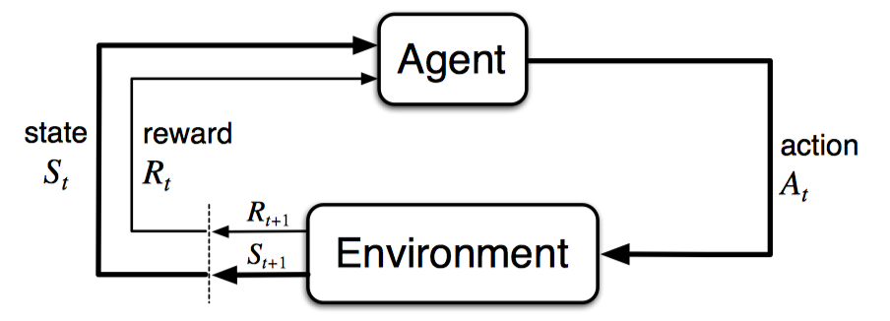
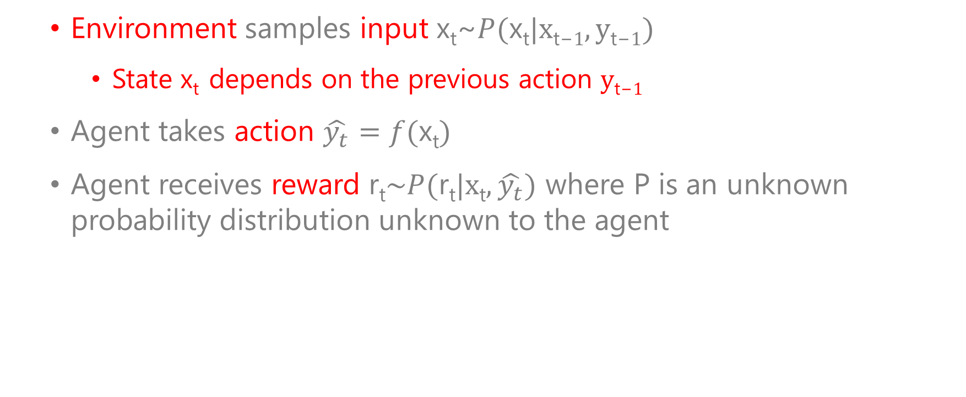
Reinforcement Learning
Environment samples input x_{t}~$P(\text{x}\text{t}|\text{x}\text{t}\text{−}1,\text{y}\text{t}\text{−}1)$
State x_{t} depends on the previous action $\text{y}\text{t}\text{−}1$
Agent takes action $\hat{y_{t}}=f(\text{x}\text{t})$
Agent receives reward $\text{r}\text{t}\sim P(\text{r}\text{t}|\text{x}\text{t},\hat{y_{t}})$ where P is an unknown probability distribution unknown to the agent

Slide 6
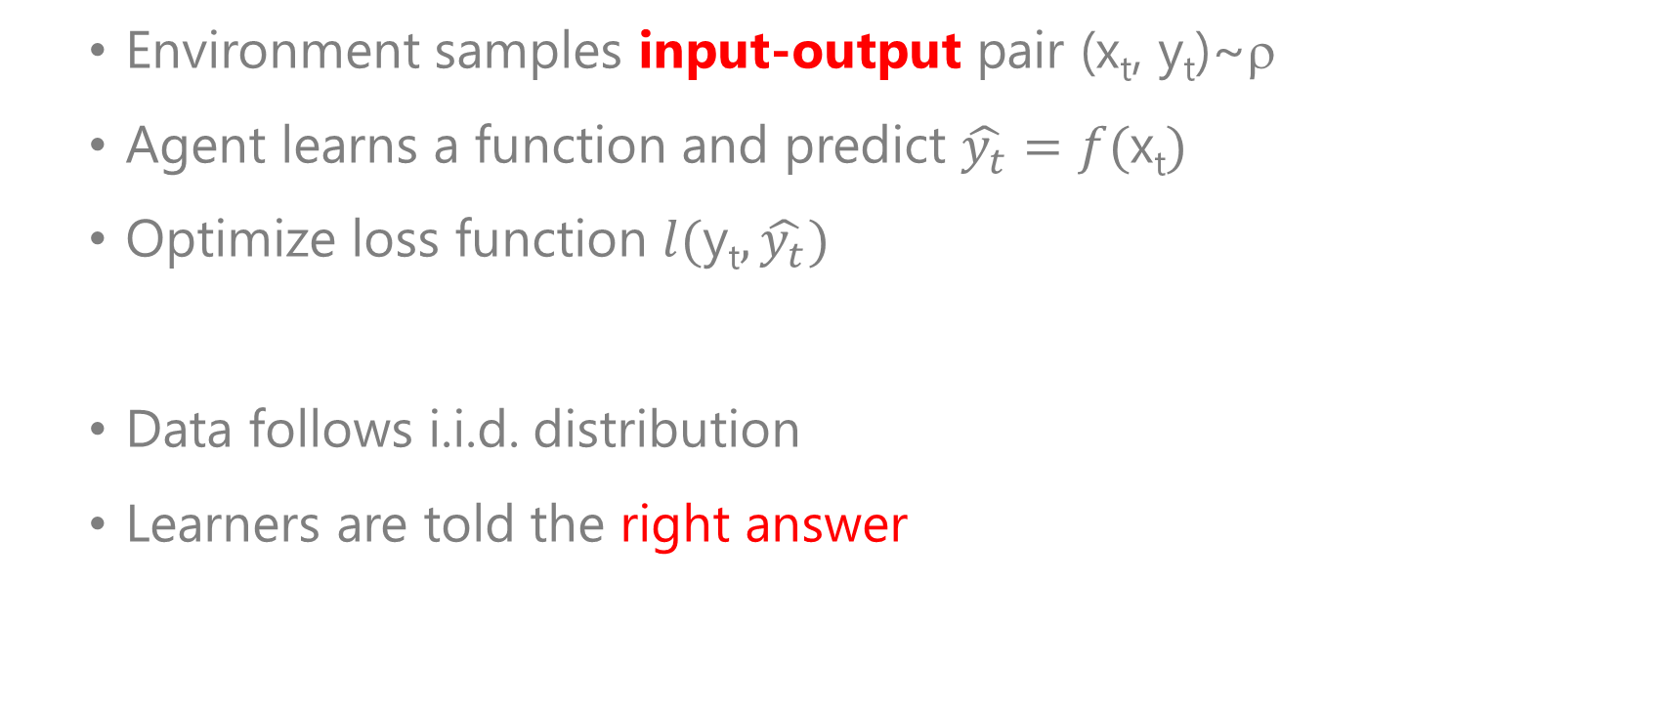
Supervised Learning
Environment samples input-output pair (x_{t}, y_{t})~ρ
Agent learns a function and predict $\hat{y_{t}}=f(\text{x}\text{t})$
Optimize loss function $l(\text{y}\text{t},\hat{y_{t}})$
Data follows i.i.d. distribution
Learners are told the right answer

Slide 7
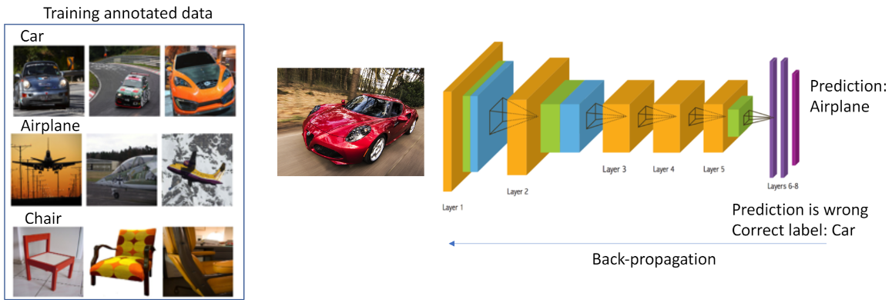
Supervised Learning: Image Classification
Data follows i.i.d. distribution
Learners are told the right answer

Slide 8
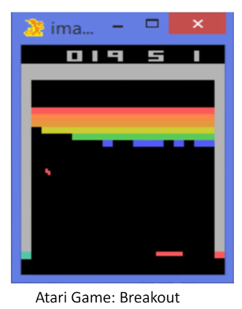
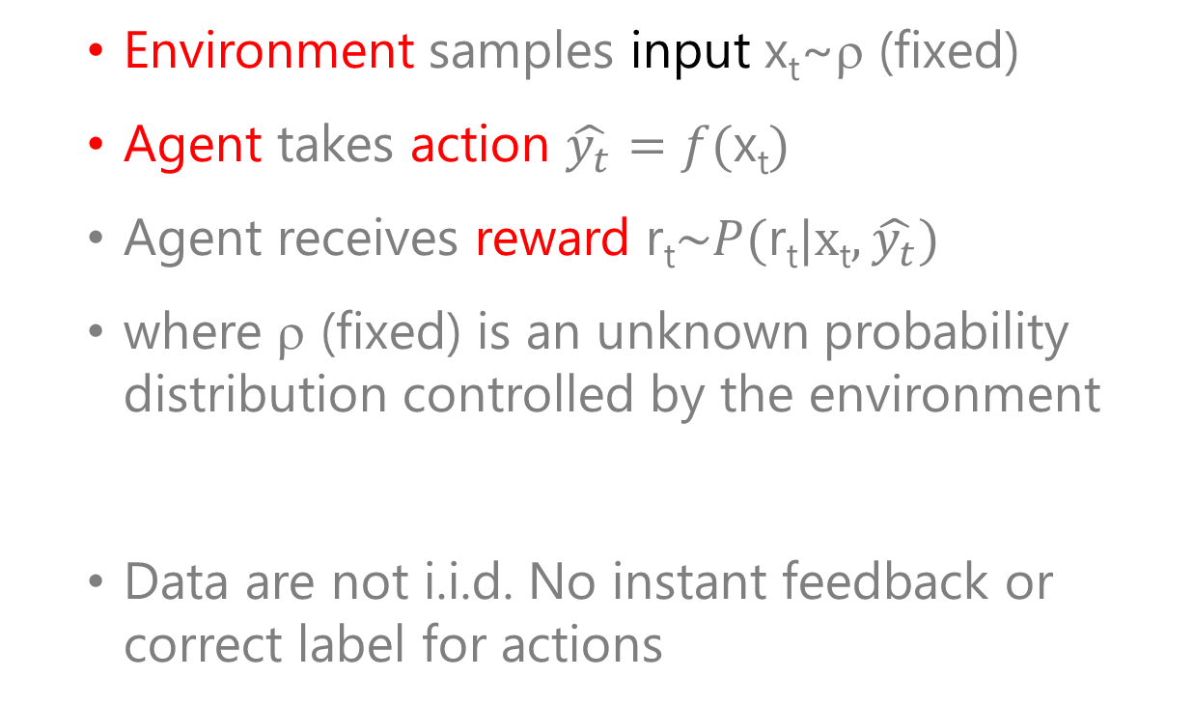
Reinforcement Learning: Playing Breakout
Environment samples input x_{t}~ρ (fixed)
Agent takes action $\hat{y_{t}}=f(\text{x}\text{t})$
Agent receives reward $\text{r}\text{t}\sim P(\text{r}\text{t}|\text{x}\text{t},\hat{y_{t}})$
where ρ (fixed) is an unknown probability distribution controlled by the environment
Data are not i.i.d. No instant feedback or correct label for actions

Slide 9
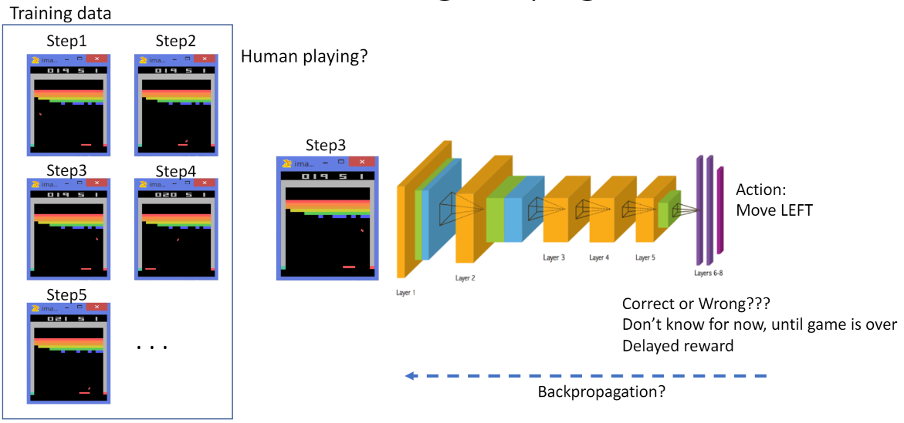
Reinforcement Learning: Playing Breakout

Slide 10



Multi-Armed Bandit Problem
A row of slot machines (吃角子老虎)
Personalized news recommendation
Test ad placement on websites
Random allocation in clinical trials
Variant #1 CTR: 3.3%
Variant #2 CTR: 3.9%

Slide 11
How Does RL Relate to Other ML Problems?
From supervised learning
Collecting (observation, action) pairs
Minimize the loss
Contextual bandits
You don’t have full access to the function you’re trying to optimize
You must query it through interaction
The system only gives you reward (instead of corresponding action labels)
Reinforcement learning
Interacting with a stateful world: state x_{t} depends on your previous actions
i.i.d. data
known ground truth outputs in training

Slide 12
Supervised Learning vs. Reinforcement Learning
Supervised Learning
Reinforcement Learning
Data follows i.i.d. distribution
Learners are told the right answer
Sequential data as input (not i.i.d.)
The learners don’t know which actions are correct
Trial-and-error exploration
Delayed reward
Agent’s actions affect the environment

Slide 13
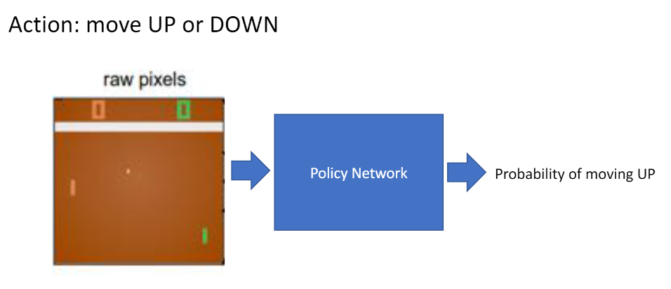
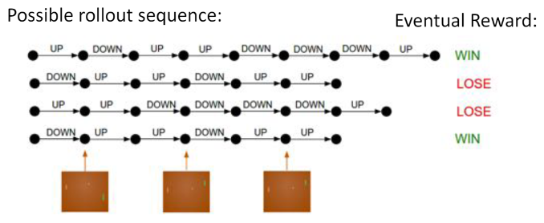
RL example: Playing Pong
Play the game until game is over, then penalize each action

Slide 14
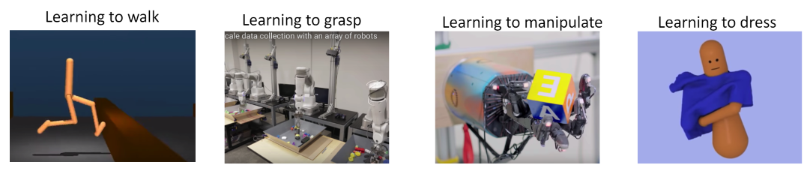
Other Examples on RL
Chess players play to win: +/- reward for wining or losing a game
Manage stock investment: +/- reward for each profit or loss in $
Play Atari games: +/- reward for increasing or decreasing scores

Slide 15
Sequential Decision Making
Full observability: Markov Decision Process (MDP)
Partial observability: POMDP

Slide 16
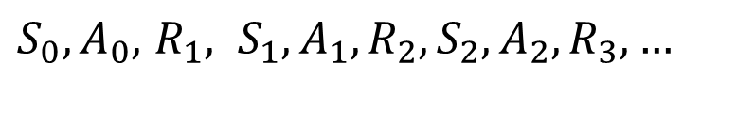
Markov Decision Process
What is MDP?
$S_{0},A_{0},$ $R_{1}, S_{1},A_{1},R_{2}, S_{2},A_{2},R_{3}, …$

Slide 17
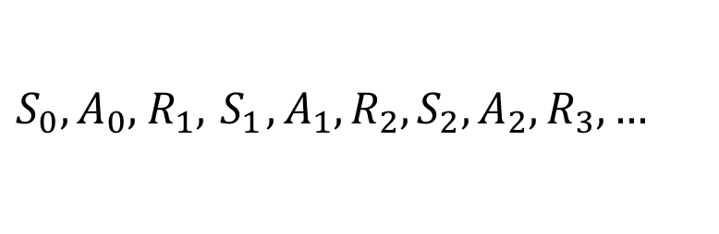
MDP: Definition
Markov Decision Process (MDP) defined by (S, A, P, r), where
S: state space
A: action space
P(r, s’| s, a): transition + reward prob. Dist.
Extra objects defined depending on problem setting
μ: Initial state distribution
Optimization problem to maximize expected cumulative reward
$S_{0},A_{0},$ $R_{1}, { S}_{1},A_{1},R_{2}, S_{2},A_{2},R_{3}, …$

Slide 18
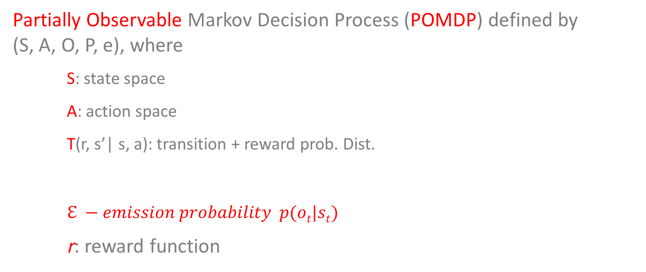
POMDP: Definition
Partially Observable Markov Decision Process (POMDP) defined by (S, A, O, P, e), where
S: state space
A: action space
T(r, s’| s, a): transition + reward prob. Dist.
$ℇ −emission probability p(ot|st)$
r: reward function
$S_{0},A_{0},$ $R_{1}, { S}_{1},A_{1},R_{2}, S_{2},A_{2},R_{3}, …$

Slide 19
Major Components of an RL Agent
Policy
Value function
Model

Slide 20
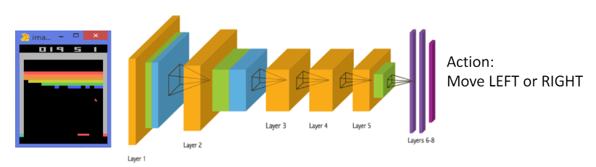
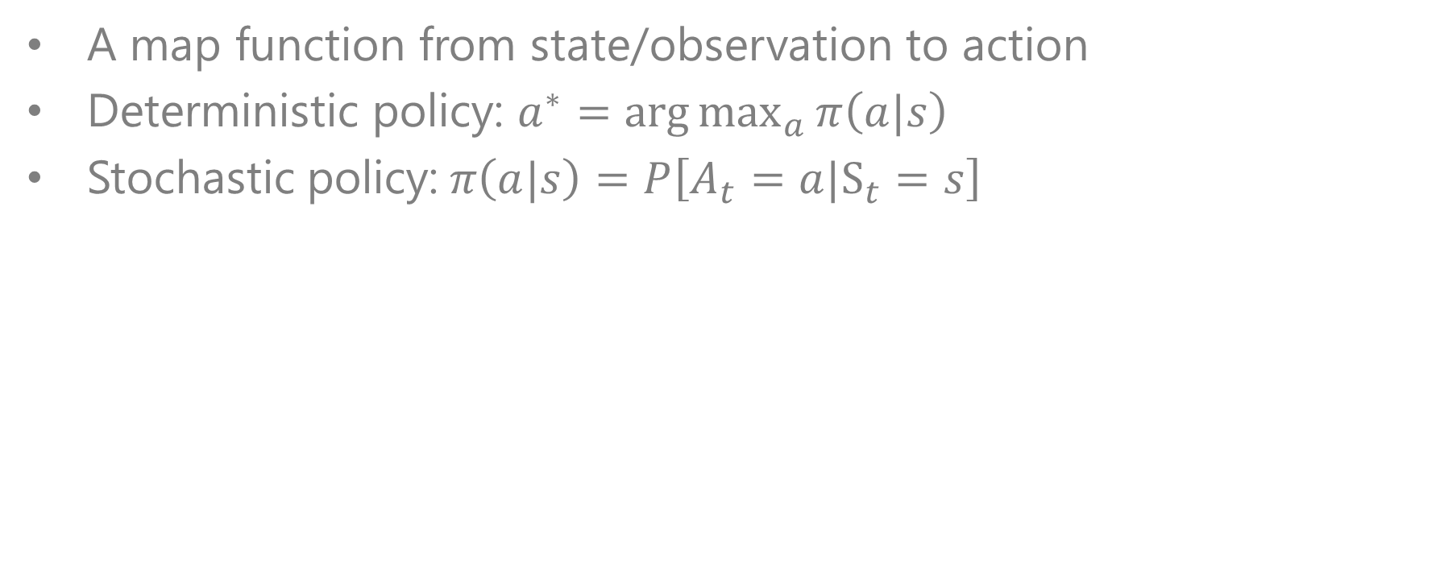
Policy
A map function from state/observation to action
Deterministic policy: $a^{∗}=\arg{\max_{a}{π\left(a|s\right)}}$
Stochastic policy:$π\left(a|s\right)=P\left[A_{t}=a|S_{t}=s\right]$

Slide 21
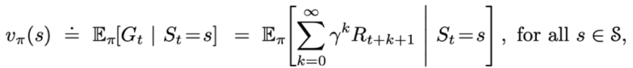
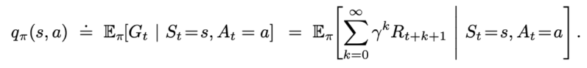
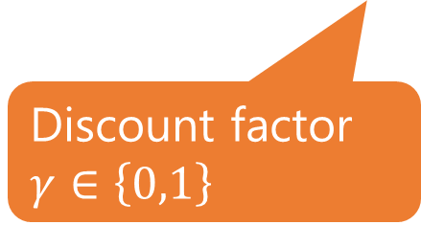
Value Function
Expected discounted sum of future rewards under a particular policy π
Used to quantify goodness/badness of states and actions
Q-function: estimate the goodness of an action a at state s,
Discount factor $γ∈\left\{0,1\right\}$

Slide 22
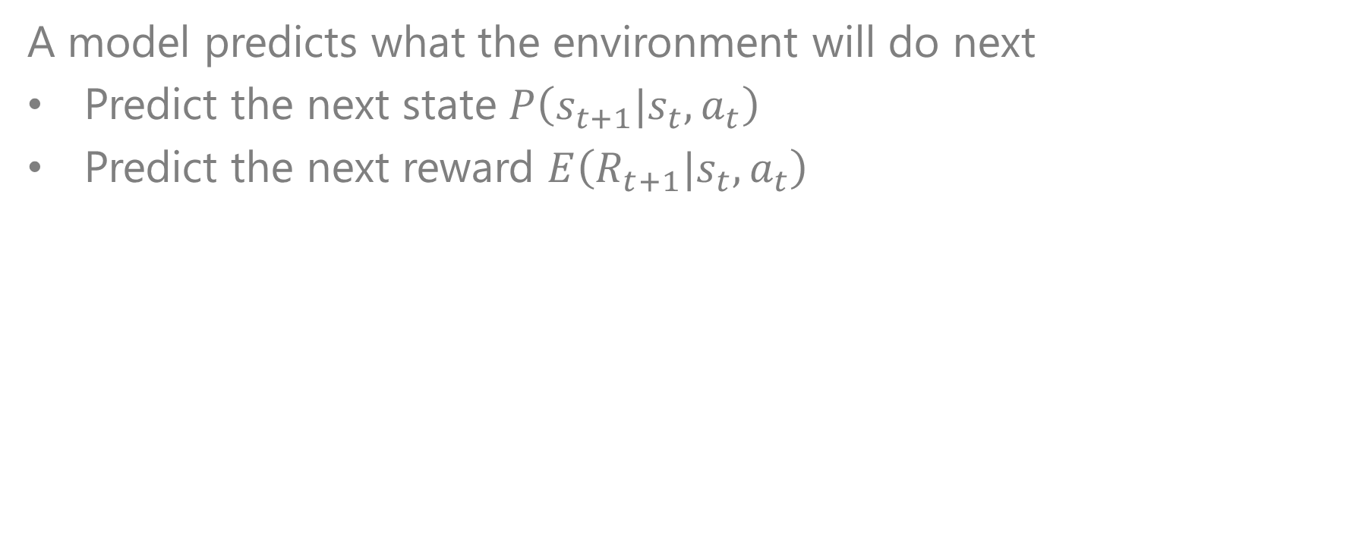
Model
A model predicts what the environment will do next
Predict the next state $P\left(s_{t+1}|s_{t},a_{t}\right)$
Predict the next reward $E\left(R_{t+1}|s_{t},a_{t}\right)$

Slide 23
Types of RL Agents Based on
What the Agent Learns
If there is model
Value-based Agent:
Explicit: value function
Implicit: Policy
Policy-based Agent:
Explicit: Policy
No value function
Actor-Critic Agent
Model-based
Explicit: Model
May or may not have policy and value function
Model-free
Explicit: Value function and/or policy function
No model
http://rl-gym-doc.s3-website-us-west-2.amazonaws.com/mlss/2016-MLSS-RL.pdf

Slide 24
Exploration and Exploitation
Exploration:
trying new things that might enable the agent to make better decisions in the future
Exploitation:
choosing actions that are expected to yield good reward given the past experience
Trade-off between exploration and exploitation

Slide 25
Parameterized Policies
A family of policies indexed by parameter vector θ
Deterministic policies: a=π_{θ}(s)
Stochastic policies: a∼π_{θ}(a|s)
Analogous to classification or regression with input s, output a.
Discrete action space: network outputs vector of probabilities 1
Continuous action space: network outputs mean and diagonal covariance of Gaussian
Dependency of variables:
r → a → π→ θ
(在 [投影片放映] 模式中按一下箭頭)
Notes:
在 [投影片放映] 模式中，按一下箭頭即可進入 PowerPoint 快速入門中心。

Slide 26
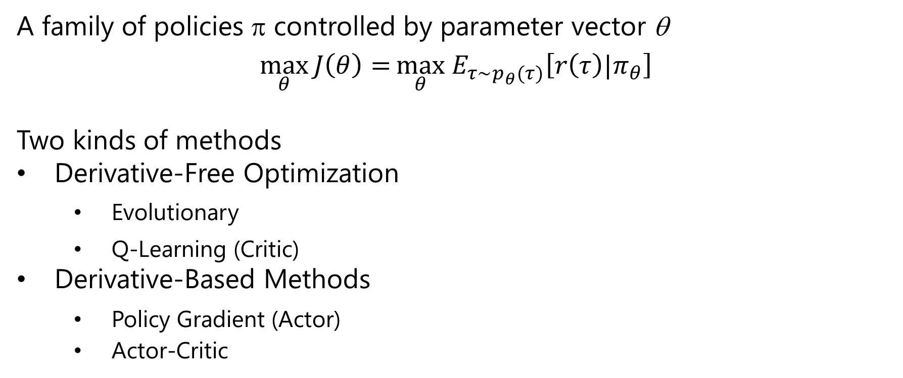

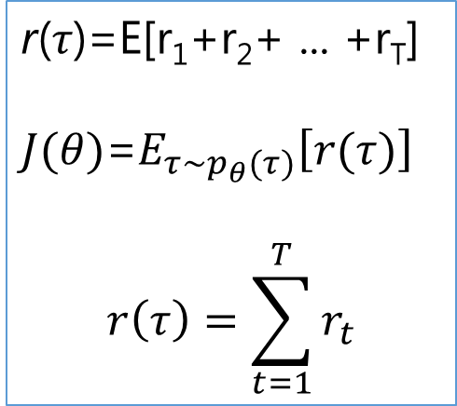
Goal of Reinforcement Learning $J\left(θ\right)$?
A family of policies π controlled by parameter vector θ
$$\max_{θ}{J\left(θ\right)=}\max_{θ} E_{τ\sim p_{θ}(τ)}\left[r\left(τ\right)|π_{θ}\right]$$
Two kinds of methods
Derivative-Free Optimization
Evolutionary
Q-Learning (Critic)
Derivative-Based Methods
Policy Gradient (Actor)
Actor-Critic
$$\text{r}\text{(}τ\text{)=}\text{E}\text{[}\text{r}\text{1}\text{+}\text{r}\text{2}\text{+ ... +}\text{r}\text{T}\text{]}$$
$J(θ)$=$E_{τ\sim p_{θ}(τ)}\left[r(τ)\right]$
$$r\left(τ\right)=\sum_{t=1}^{T}{r_{t}}$$

Slide 27

下列關於Markov Decision Process 的敘述何者錯誤?
ⓘ Start presenting to display the poll results on this slide.

Slide 28
Policy Gradient Methods
Prof. Hung-Yi Lee@NTU: Slide, Video (Chinese)
Prof. Sergey Levine@UC Berkeley: Slide, Video (English)

Slide 29
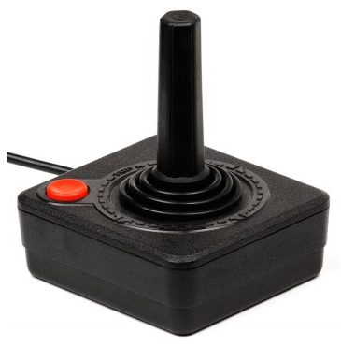
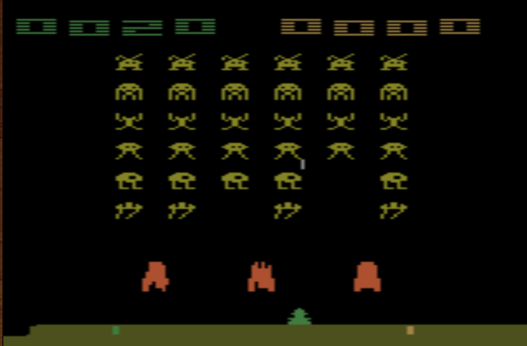
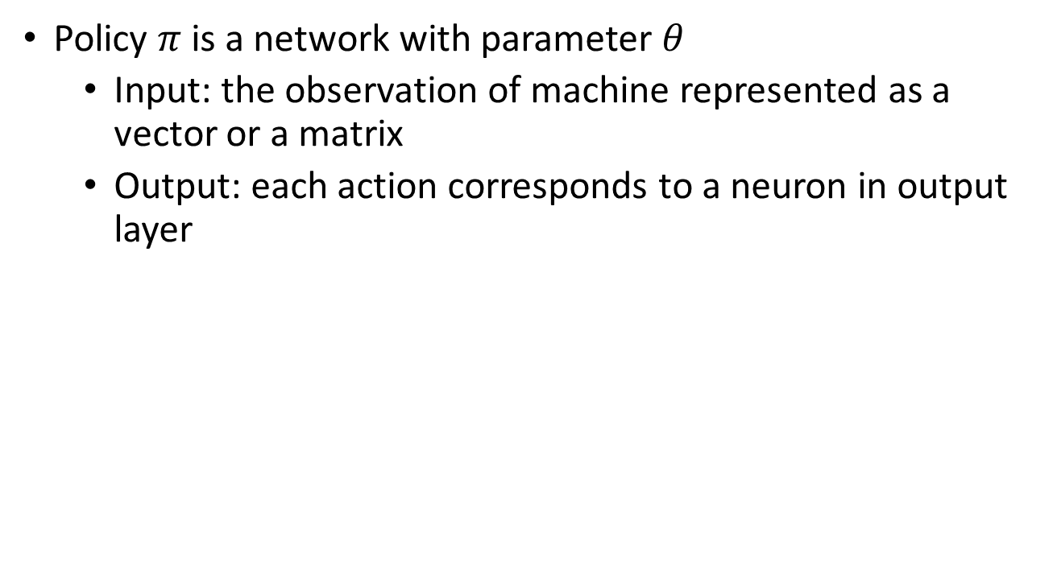
Policy is a Neural Network
Policy $π$ is a network with parameter $θ$
Input: the observation of machine represented as a vector or a matrix
Output: each action corresponds to a neuron in output layer
Take the action based on the probability.
left
0.7
…
right
0.2
Score of an action
…
fire
0.1
pixels
Notes:
Taking the action with the highest score

Slide 30
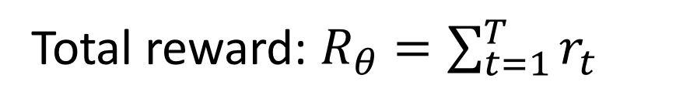
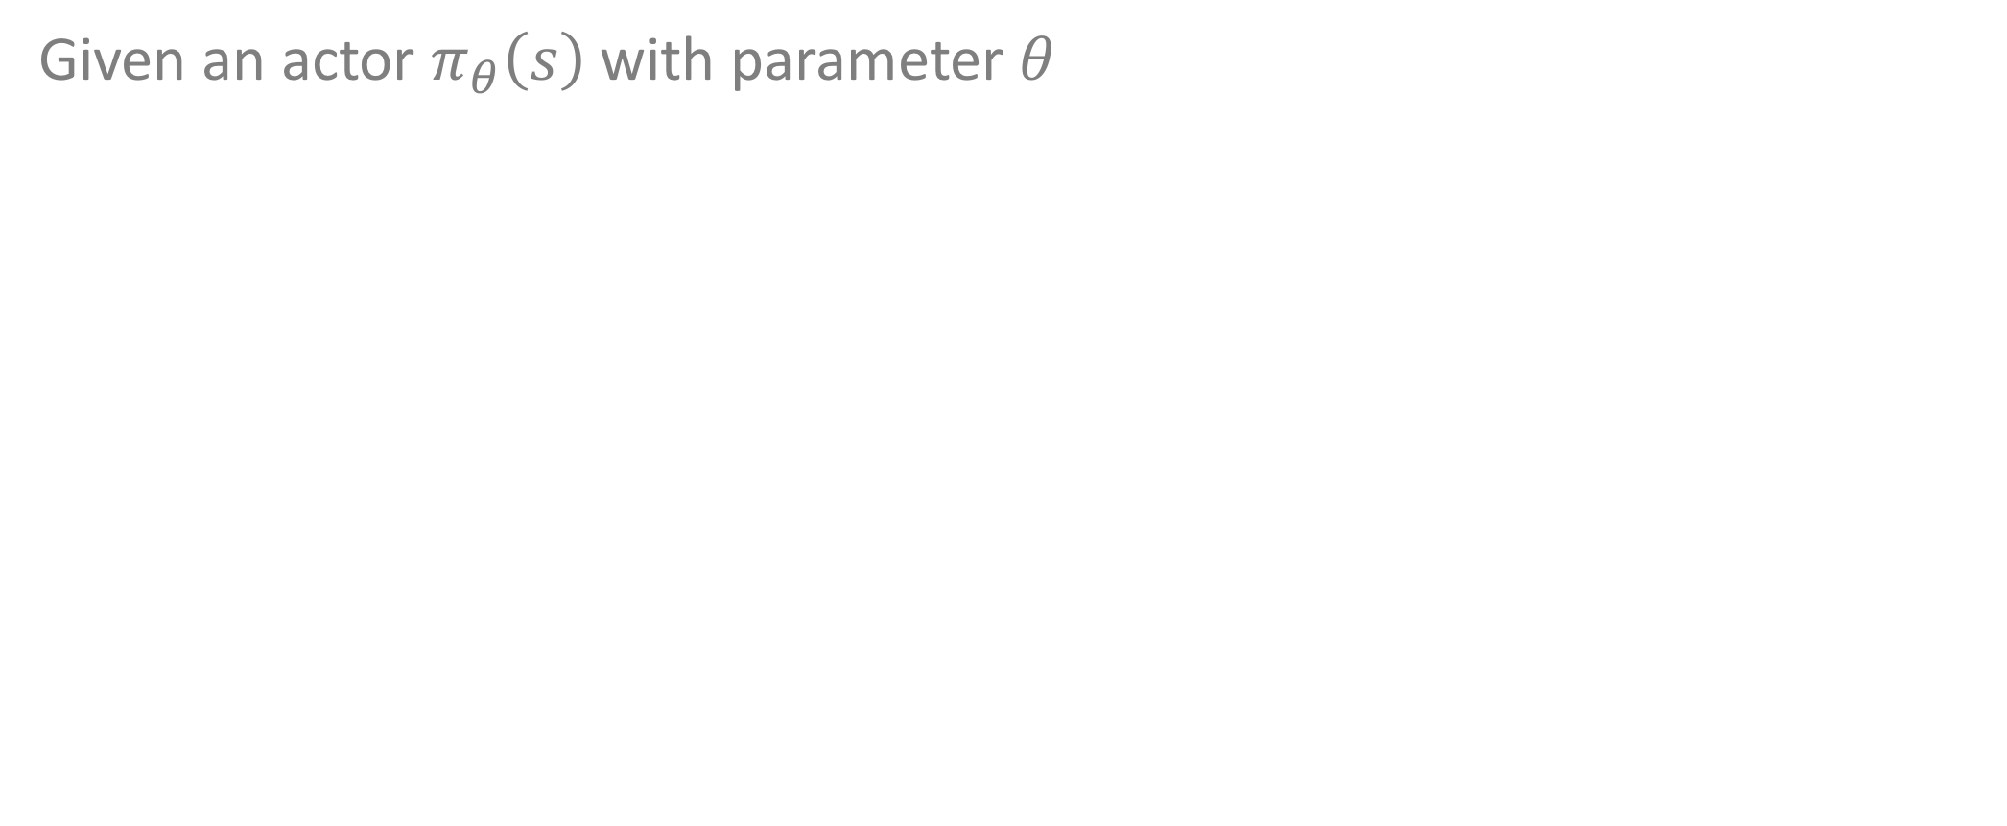
Goodness of a Policy (Cost Function)
Given an actor $π_{θ}\left(s\right)$ with parameter $θ$
Total reward: $R_{θ}=\sum_{t=1}^{T}{r_{t}}$
Even with the same actor, $R_{θ}$ is different each time
Randomness in the actor and the game
We define ${\overline{R}}_{θ}$ as the expected value of $R_{θ}$
${\overline{R}}_{θ}$ evaluates the goodness of an actor $π_{θ}\left(s\right)$

Slide 31
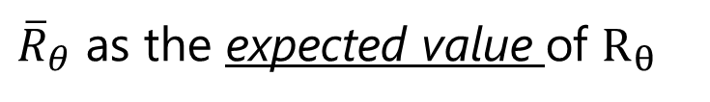
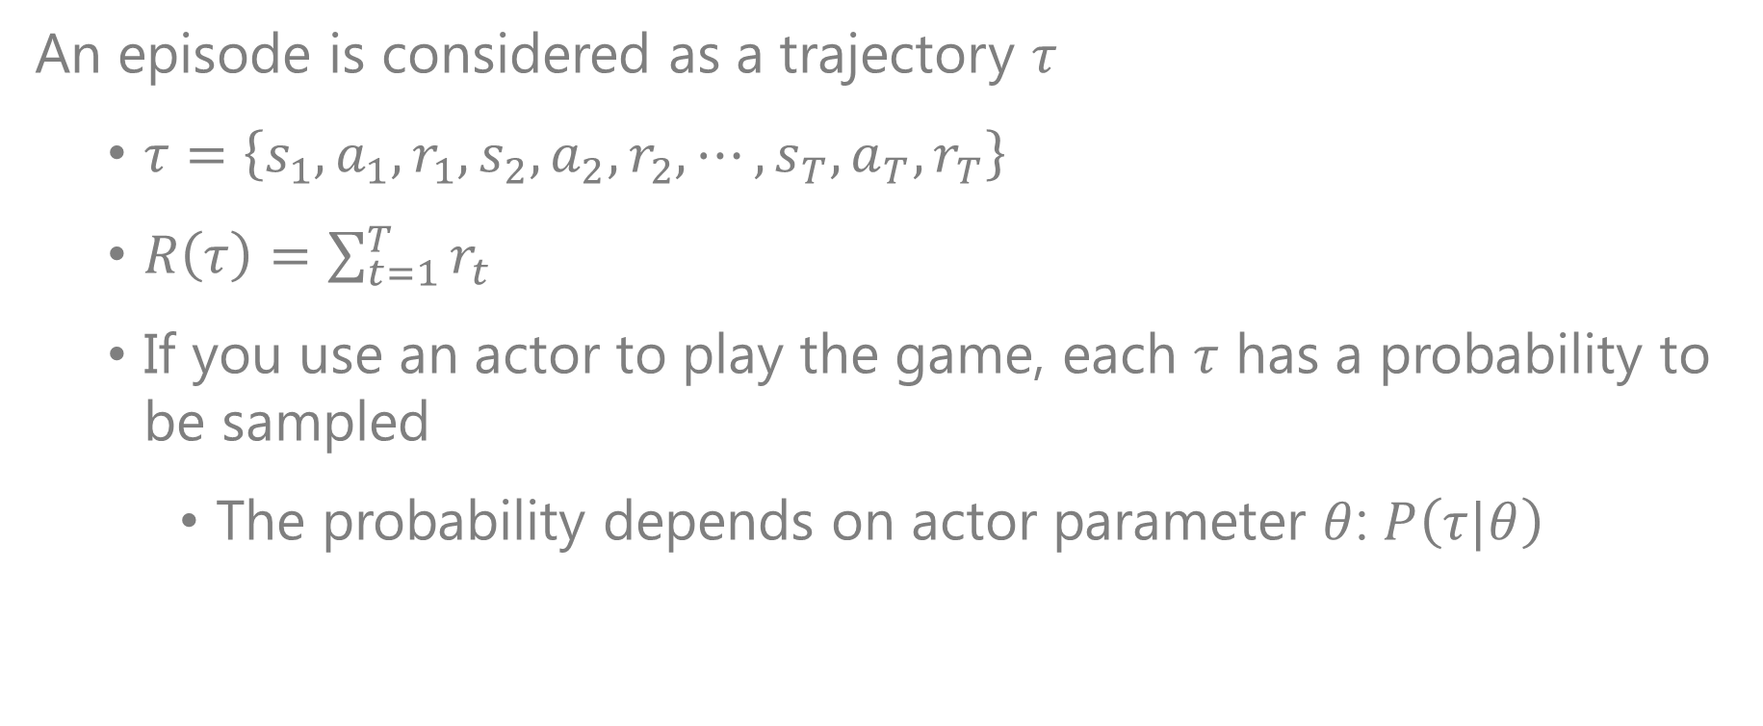
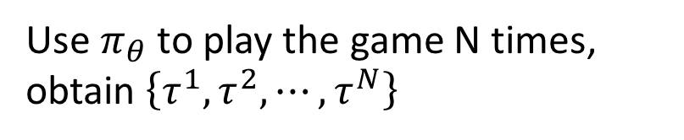
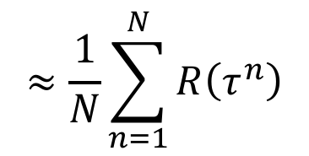
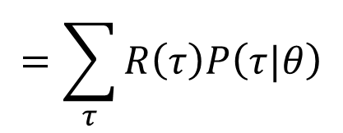
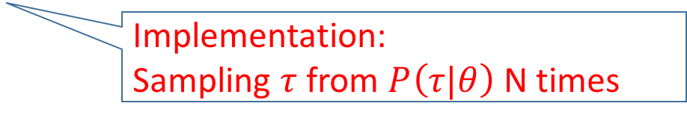
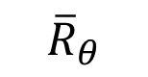
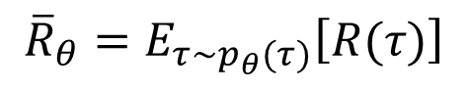
Goodness of the Policy: the Cumulated Reward
An episode is considered as a trajectory $τ$
$τ=\left\{s_{1},a_{1},r_{1},s_{2},a_{2},r_{2},⋯,s_{T},a_{T},r_{T}\right\}$
$R\left(τ\right)=\sum_{t=1}^{T}{r_{t}}$
If you use an actor to play the game, each $τ$ has a probability to be sampled
The probability depends on actor parameter $θ$: $P\left(τ|θ\right)$
${\overline{R}}_{θ}$ as the expected value of $R_{θ}$
$$=\sum_{τ}{R\left(τ\right)P\left(τ|θ\right)}$$
$$≈\frac{1}{N}\sum_{n=1}^{N}{R\left(τ^{n}\right)}$$
Use $π_{θ}$ to play the game N times,
obtain $\left\{τ^{1},τ^{2},⋯,τ^{N}\right\}$
$${\overline{R}}_{θ}$$
Sum over all possible trajectory
Implementation:
Sampling $τ$ from $P\left(τ|θ\right)$ N times
$${\overline{R}}_{θ}=E_{τ\sim p_{θ}(τ)}\left[R(τ)\right]$$
Notes:
Why don’t we multiple P anymore

Slide 32
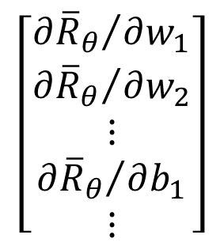
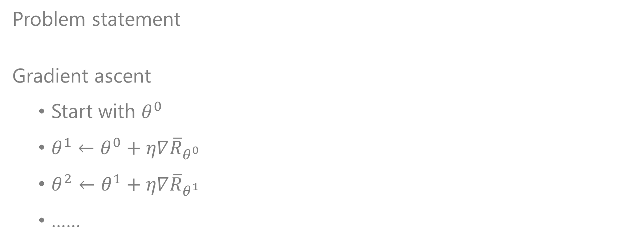
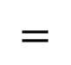
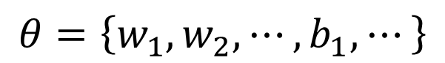
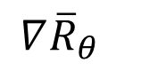
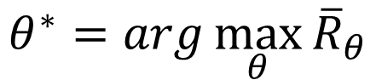
Gradient Ascent
Problem statement
Gradient ascent
Start with $θ^{0}$
$θ^{1}←θ^{0}+η∇{\overline{R}}_{θ^{0}}$
$θ^{2}←θ^{1}+η∇{\overline{R}}_{θ^{1}}$
……
$$θ^{∗}=arg\max_{θ}{{\overline{R}}_{θ}}$$
$$θ=\left\{w_{1},w_{2},⋯,b_{1},⋯\right\}$$
$$\left[\begin{aligned}{∂{\overline{R}}_{θ}}/{∂w_{1}} \\ {∂{\overline{R}}_{θ}}/{∂w_{2}} \\ ⋮ \\ {∂{\overline{R}}_{θ}}/{∂b_{1}} \\ ⋮\end{aligned}\right]$$
$$∇{\overline{R}}_{θ}$$
$$=$$

Slide 33
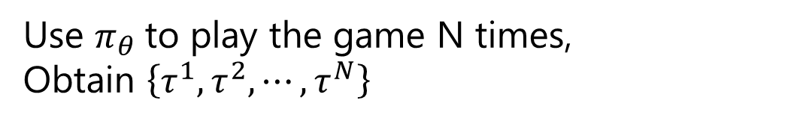
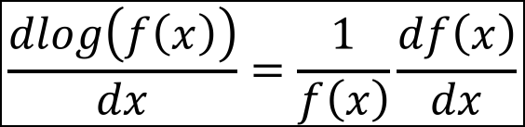
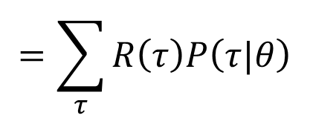
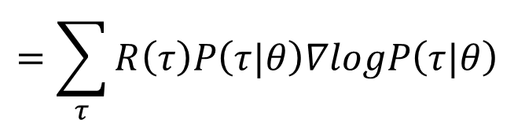
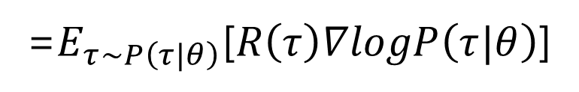
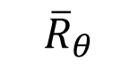
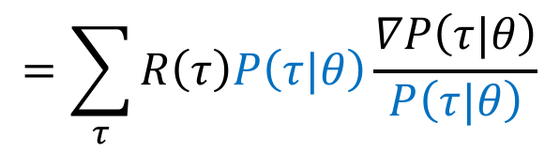
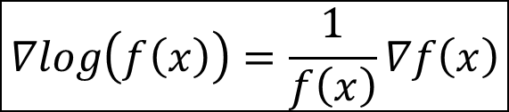
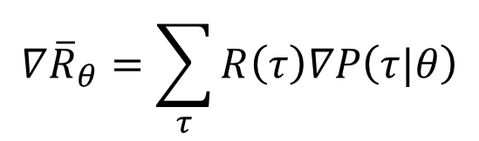
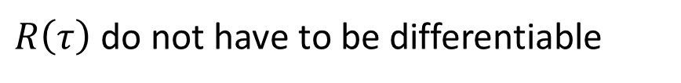


Policy Gradient
$$=\sum_{τ}{R\left(τ\right)P\left(τ|θ\right)}$$
$${\overline{R}}_{θ}$$
$$∇{\overline{R}}_{θ}=?$$
$$∇{\overline{R}}_{θ}=\sum_{τ}{R\left(τ\right)∇P\left(τ|θ\right)}$$
$$=\sum_{τ}{R\left(τ\right)P\left(τ|θ\right)\frac{∇P\left(τ|θ\right)}{P\left(τ|θ\right)}}$$
$R\left(τ\right)$ do not have to be differentiable
$$∇log\left(f\left(x\right)\right)=\frac{1}{f\left(x\right)}∇f\left(x\right)$$
It can even be a black box.
$$=\sum_{τ}{R\left(τ\right)P\left(τ|θ\right)∇logP\left(τ|θ\right)}$$
=$E_{τ\sim P\left(τ|θ\right)}$[$R\left(τ\right)∇logP\left(τ|θ\right)$]
$$≈\frac{1}{N}\sum_{n=1}^{N}{R\left(τ^{n}\right)∇logP\left(τ^{n}|θ\right)}$$
Use $π_{θ}$to play the game N times,
Obtain $\left\{τ^{1},τ^{2},⋯,τ^{N}\right\}$
$$\frac{dlog\left(f\left(x\right)\right)}{dx}=\frac{1}{f\left(x\right)}\frac{df\left(x\right)}{dx}$$

Slide 34





How to Calculate
$$∇logP\left(τ|θ\right)?$$
$$τ=\left\{s_{1},a_{1},r_{1},s_{2},a_{2},r_{2},⋯,s_{T},a_{T},r_{T}\right\}$$
Markov Property:
$$P\left(τ|θ\right)=$$
$$p\left(s_{1}\right)π\left(a_{1}|s_{1},θ\right)p\left(r_{1},s_{2}|s_{1},a_{1}\right)π\left(a_{2}|s_{2},θ\right)p\left(r_{2},s_{3}|s_{2},a_{2}\right)⋯$$
$$P\left(τ|θ\right)=p\left(s_{1}\right)\prod_{t=1}^{T}{π\left(a_{t}|s_{t},θ\right)p\left(r_{t},s_{t+1}|s_{t},a_{t}\right)}$$
$$logP\left(τ|θ\right)=logp\left(s_{1}\right)+\sum_{t=1}^{T}{logπ\left(a_{t}|s_{t},θ\right)}+logp\left(r_{t},s_{t+1}|s_{t},a_{t}\right)$$

Slide 35




How to Calculate
$$∇logP\left(τ|θ\right)?$$
$$Take derivative w.r.t. θ$$
Environment is not related to $θ$
$$logP\left(τ|θ\right)=logp\left(s_{1}\right)+\sum_{t=1}^{T}{logp\left(a_{t}|s_{t},θ\right)}+logp\left(r_{t},s_{t+1}|s_{t},a_{t}\right)$$
$$∇logP\left(τ|θ\right)=\sum_{t=1}^{T}{∇logp\left(a_{t}|s_{t},θ\right)}$$
Ignore the terms not related to $θ$

Slide 36






Policy Gradient Optimization
$$∇{\overline{R}}_{θ}≈\frac{1}{N}\sum_{n=1}^{N}{R\left(τ^{n}\right)∇logP\left(τ^{n}|θ\right)}$$
$$=\frac{1}{N}\sum_{n=1}^{N}{R\left(τ^{n}\right)\sum_{t=1}^{T_{n}}{∇logp\left(a_{t}^{n}|s_{t}^{n},θ\right)}}$$
$$=\frac{1}{N}\sum_{n=1}^{N}{\sum_{t=1}^{T_{n}}{R\left(τ^{n}\right)∇logp\left(a_{t}^{n}|s_{t}^{n},θ\right)}}$$
$$θ^{new}←θ^{old}+η∇{\overline{R}}_{θ^{old}}$$
Tuning $θ$ to decrease $p\left(a_{t}^{n}|s_{t}^{n}\right)$
It is very important to consider the cumulative reward $R\left(τ^{n}\right)$ of the whole trajectory $τ^{n}$ instead of immediate reward $r_{t}^{n}$

Slide 37


















Policy Gradient
Update Model
$$θ←θ+η∇{\overline{R}}_{θ}$$
Given actor parameter $θ$
$$\frac{1}{N}\sum_{n=1}^{N}{\sum_{t=1}^{T_{n}}{R\left(τ^{n}\right)∇logp\left(a_{t}^{n}|s_{t}^{n},θ\right)}}$$
$$∇{\overline{R}}_{θ}=$$
$$τ^{1}:$$
$$\left(s_{1}^{1},a_{1}^{1}\right)$$
$$R\left(τ^{1}\right)$$
$$\left(s_{2}^{1},a_{2}^{1}\right)$$
$$R\left(τ^{1}\right)$$
$$a_{1}^{1}=left$$
NN
left
1
……
……
$$s_{1}^{1}$$
right
0
$$τ^{2}:$$
$$\left(s_{1}^{2},a_{1}^{2}\right)$$
$$R\left(τ^{2}\right)$$
fire
0
$$\left(s_{2}^{2},a_{2}^{2}\right)$$
$$R\left(τ^{2}\right)$$
…
$$a_{1}^{2}=fire$$
……
……
NN
left
0
$$s_{1}^{2}$$
right
0
Data Collection
1
fire

Slide 38





Tip 1: Add a Baseline
$$θ^{new}←θ^{old}+η∇{\overline{R}}_{θ^{old}}$$
It is possible that $R\left(τ^{n}\right)$ is always positive.
$$\frac{1}{N}\sum_{n=1}^{N}{\sum_{t=1}^{T_{n}}{\left(R\left(τ^{n}\right)−b\right)∇logp\left(a_{t}^{n}|s_{t}^{n},θ\right)}}$$
$$∇{\overline{R}}_{θ}≈\frac{1}{N}\sum_{n=1}^{N}{\sum_{t=1}^{T_{n}}{R\left(τ^{n}\right)∇logp\left(a_{t}^{n}|s_{t}^{n},θ\right)}}$$
$$b≈E\left[R\left(τ\right)\right]$$
It is probability …
Ideal
case
a
b
c
a
b
c
Not sampled
The probability of the actions not sampled will decrease.
Sampling
……
a
b
c
a
b
c

Slide 39






Tip 2: Assign Suitable Credit
Advantage Function
How good it is if we take action $a_{t}$ rather than other actions
Can be estimated by critic (later)
Can be state-dependent
$$A^{θ}\left(s_{t},a_{t}\right)$$
$$∇{\overline{R}}_{θ}≈\frac{1}{N}\sum_{n=1}^{N}{\sum_{t=1}^{T_{n}}{\left(R\left(τ^{n}\right)−b\right)∇logp_{θ}\left(a_{t}^{n}|s_{t}^{n}\right)}}$$
$$\sum_{t^{′}=t}^{T_{n}}{r_{t^{′}}^{n}}$$
$$\sum_{t^{′}=t}^{T_{n}}{\left(d^{t^{′}−t}\right)r_{t^{′}}^{n}}$$
Consider only rewards after the action
$$d<1$$
Add discount factor d

Slide 40
下列關於Policy Gradient Methods 敘述何者錯誤?(多選)
ⓘ Start presenting to display the poll results on this slide.

Slide 41
Value Function and Q-Learning

Slide 42







Value Function and Critic
The output values of a critic depend on the actor evaluated.
State value function $V^{π}\left(s\right)$
The cumulated reward expects to be obtained after visiting state s when using actor $π$.
A critic does not directly determine the action but evaluates how good the actor is.
$$V^{π}$$
$$V^{π}\left(s\right)$$
s
scalar
$V^{π}\left(s\right)$ is large
$V^{π}\left(s\right)$ is smaller
Notes:
(Lots of aliens to be killed, and the shields still exist)

Slide 43














1st method to estimate $V^{π}\left(s\right)$? – MC based approach
Solving a Regression Problem
Monte-Carlo (MC) based approach
The critic watches $π$ playing the game
After seeing $s_{a}$,
$$V^{π}$$
$G_{a}$ : the cumulated reward until the end of the episode = r_{a}+r_{b}+…
$$s_{a}$$
$$V^{π}\left(s_{a}\right)$$
$G_{a}$
After seeing $s_{b}$,
$$V^{π}$$
$G_{b}$ : the cumulated reward until the end of the episode = r_{b}+…
$$s_{b}$$
$$V^{π}\left(s_{b} \right)$$
$G_{b}$

Slide 44









2nd method to estimate $V^{π}\left(s\right)$? – TD approach
Temporal-difference (TD) approach
$$⋯s_{t},a_{t},r_{t},s_{t+1}⋯$$
$$V^{π}$$
$$V^{π}\left(s_{t}\right)=V^{π}\left(s_{t+1} \right)+r_{t}$$
$$s_{t}$$
$$V^{π}\left(s_{t}\right)$$
-
$$V^{π}\left(s_{t}\right)−V^{π}\left(s_{t+1}\right)$$
$$r_{t}$$
$$V^{π}$$
$$s_{t+1}$$
$$V^{π}\left(s_{t+1}\right)$$
Some applications have very long episodes, so that delaying all learning until an episode's end is too slow.
Notes:
The next most obvious advantage of TD methods over Monte Carlo methods is
that they are naturally implemented in an on-line, fully incremental fashion. With
Monte Carlo methods one must wait until the end of an episode, because only then
is the return known, whereas with TD methods one need wait only one time step.
Surprisingly often this turns out to be a critical consideration Other applications are continuing tasks and have no episodes at all.

Slide 45












Comparison of MC v.s. TD
$$Var\left[kX\right]=k^{2}Var\left[X\right]$$
$$V^{π}$$
Larger variance
$$s_{a}$$
$$V^{π}\left(s_{a}\right)$$
$G_{a}$
$G_{a}$ is the summation of many steps
$$V^{π}$$
$$V^{π}$$
$$s_{t}$$
$$V^{π}\left(s_{t}\right)$$
$$r+$$
$$V^{π}\left(s_{t+1}\right)$$
$$s_{t+1}$$
Smaller variance
May be inaccurate

Slide 46





MC v.s. TD
[Sutton, v2, Example 6.4]
The critic has the following 8 episodes
$s_{a},r=0,s_{b},r=0$, END
$s_{b},r=1$, END
$s_{b},r=1$, END
$s_{b},r=1$, END
$s_{b},r=1$, END
$s_{b},r=1$, END
$s_{b},r=1$, END
$s_{b},r=0$, END
$$V^{π}\left(s_{b}\right)=6/8=3/4$$
$$V^{π}\left(s_{a}\right)=?$$
Monte-Carlo:
$$V^{π}\left(s_{a}\right)=0$$
Temporal-difference:
$$V^{π}\left(s_{a}\right)=V^{π}\left(s_{b}\right)+r$$
3/4
3/4
0
(The actions are ignored here.)

Slide 47







Another Critic
State-action value function $Q^{π}\left(s,a\right)$
The cumulated reward expects to be obtained after taking a at state s when using actor $π$.
Implementation: To speedup the testing, change output to a vector of values (the expected reward taking corresponding actions)
$$Q^{π}$$
$$Q^{π}$$
$$Q^{π}\left(s,a=left\right)$$
s
$$Q^{π}\left(s,a\right)$$
s
$$Q^{π}\left(s,a=right\right)$$
scalar
a
$$Q^{π}\left(s,a=fire\right)$$
for discrete action only

Slide 48

How to make use of Critic: Q-Learning
$π$ interacts with the environment
𝜋 interacts with the environment
Learning $Q^{π}\left(s,a\right)$
Learning 𝑄^𝜋 (𝑠,𝑎)
Find a new actor $π^{′}$ “better” than $π$
Find a new actor 𝜋^′ “better” than 𝜋
$$π=π^{′}$$
TD or MC
?
Notes:
Add some noise

Slide 49



Q-Learning
Given $Q^{π}\left(s,a\right)$, find a new actor $π^{′}$ “better” than $π$
“Better”: $V^{π^{′}}\left(s\right)≥V^{π}\left(s\right)$, for all state s
Always take the action with the largest reward
$$π^{′}\left(s\right)=arg\max_{a}{Q^{π}\left(s,a\right)}$$
$π^{′}$ does not have extra parameters. It depends on Q
Not suitable for continuous action a (solve it later)

Slide 50









Q-Learning
$V^{π^{′}}\left(s\right)≥V^{π}\left(s\right)$, for all state s
$$π^{′}\left(s\right)=arg\max_{a}{Q^{π}\left(s,a\right)}$$
Definition of $π^{′}\left(s\right)$
$$V^{π}\left(s\right)=Q^{π}\left(s,π\left(s\right)\right)$$
$$≤\max_{a}{Q^{π}\left(s,a\right)}$$
$$=Q^{π}\left(s,π^{′}\left(s\right)\right)$$
$$V^{π}\left(s\right)$$
$$≤Q^{π}\left(s,π^{′}\left(s\right)\right)$$
$$=E[r_{t+1}+V^{π}\left(s_{t+1}\right)|s_{t}=s,a_{t}=π^{′}\left(s_{t}\right)]$$
$$≤E[r_{t+1}+Q^{π}\left(s_{t+1},π^{′}\left(s_{t+1}\right)\right)|s_{t}=s,a_{t}=π^{′}\left(s_{t}\right)]$$
$$=E[r_{t+1}+r_{t+2}+V^{π}\left(s_{t+2} \right)|…]$$
$$≤E[r_{t+1}+r_{t+2}+Q^{π}\left(s_{t+2},π^{′}\left(s_{t+2}\right)\right)|…]$$
$…$ $≤$ $V^{π^{′}}\left(s\right)$

Slide 51











Tip 1: Target Network
$$⋯s_{t},a_{t},r_{t},s_{t+1},a_{t+1},r_{t+1},⋯$$
Problem:
Changing Target is difficult to Train
$$Q^{π}\left(s_{t},a_{t}\right)$$
$$Q^{}$$
$$=r_{t}+Q^{π}\left(s_{t+1},π\left(s_{t+1}\right)\right)$$
$$s_{t}$$
$$Q^{π}\left(s_{t},a_{t}\right)$$
Target Network
$$a_{t}$$
regression
update
$${\hat{Q}}^{}$$
$$s_{t+1}$$
$$r_{t}+$$
$$Q^{π}\left(s_{t+1},π\left(s_{t+1}\right)\right)$$
fixed value
$$π\left(s_{t+1}\right)$$
fixed
After updating N times

Slide 52







Tip 2: Exploration
$$a_{1}$$
$$Q\left(s, a_{1}\right)=0$$
Never explore
$$s$$
$$a_{2}$$
$$Q\left(s,a_{2}\right)=0$$
1
Always sampled
$$a_{3}$$
$$Q\left(s,a_{3}\right)=0$$
Never explore
The policy is based on Q-function
This is not a good way for data collection.
$$a=arg\max_{a}{Q\left(s,a\right)}$$
Epsilon Greedy
$ε$ would decay during learning
$$a=\left\{\begin{aligned}arg\max_{a}{Q\left(s,a\right)}, \\ &random, \end{aligned}\right.$$
$$with probability 1−ε$$
$$otherwise$$
Boltzmann Exploration
$$P\left(a|s\right)=\frac{exp\left(Q\left(s,a\right)/T\right)}{\sum_{a’}{exp\left(Q\left(s,a’\right)/T\right)}}$$
Notes:
T: Temporal control

Slide 53

Tip 3: Replay Buffer
Buffer
…
exp
exp
Put the experience into buffer.
$$s_{t},a_{t},r_{t},s_{t+1}$$
exp
$π$ interacts with the environment
𝜋 interacts with the environment
Learning $Q^{π}\left(s,a\right)$
Learning 𝑄^𝜋 (𝑠,𝑎)
Find a new actor $π^{′}$ “better” than $π$
Find a new actor 𝜋^′ “better” than 𝜋
exp
…
The experience in the buffer comes from different policies.
$$π=π^{′}$$
Drop the old experience if the buffer is full.

Slide 54
Replay Buffer
Buffer
…
exp
exp
Put the experience into buffer.
$$s_{t},a_{t},r_{t},s_{t+1}$$
exp
$π$ interacts with the environment
𝜋 interacts with the environment
Learning $Q^{π}\left(s,a\right)$
Learning 𝑄^𝜋 (𝑠,𝑎)
Find a new actor $π^{′}$ “better” than $π$
Find a new actor 𝜋^′ “better” than 𝜋
exp
…
$$π=π^{′}$$
In each iteration:
1. Sample a batch
2. Update Q-function
Off-policy

Slide 55

Typical Q-Learning Algorithm
Initialize Q-function $Q$, target Q-function $\hat{Q}=Q$
In each episode
For each time step t
Given state $s_{t}$, take action $a_{t}$ based on Q // (epsilon greedy, exploration)
Obtain reward $r_{t}$, and reach new state $s_{t+1}$
Store ($s_{t}$, $a_{t}$, $r_{t}$, $s_{t+1}$) into buffer // (Replay Buffer)
Sample ($s_{i}$, $a_{i}$, $r_{i}$, $s_{i+1}$) from buffer (usually a batch)
Compute Target $y=r_{i}+\max_{a}{\hat{Q}\left(s_{i+1},a\right)}$ // Target Network
Update the parameters of $Q$ to make $Q\left(s_{i}\text{, }a_{i}\right)$ close to $y$ (regression)
Every C steps reset $\hat{Q}=Q$

Slide 56
Other Q-Learning Tips
Double DQN
Hado V. Hasselt, “Double Q-learning”, NIPS 2010
Hado van Hasselt, Arthur Guez, David Silver, “Deep Reinforcement Learning with Double Q-learning”, AAAI 2016
Dueling DQN
Ziyu Wang, Tom Schaul, Matteo Hessel, Hado van Hasselt, Marc Lanctot, Nando de Freitas, Dueling Network Architectures for Deep Reinforcement Learning, arXiv preprint, 2015
Multi-Step Reinforcement Learning
Prioritized Reply
Noisy Net: Structured Exploration
Distributional Q-function
Rainbow
Notes:
Profit sharing

Slide 57
下列關於Value Function and Q-Learning 的敘述何者錯誤?
ⓘ Start presenting to display the poll results on this slide.

Slide 58
下列關於Policy based 和 value based 的敘述何者正確?(多選)
ⓘ Start presenting to display the poll results on this slide.

Slide 59
Derivative Free Example

Slide 60




Q-Learning Example
http://mnemstudio.org/path-finding-q-learning-tutorial.htm
Reward function
State Transition
Environment Reward

Slide 61
The Q-Learning algorithm goes as follows:
1. Set the gamma parameter, and environment rewards in matrix R.
2. Initialize matrix Q to zero.
3. For each episode:
Select a random initial state state.
Do While the goal state hasn't been reached.
Select one action among all possible actions for the current state.
Using this possible action, consider going to the next state.
Get maximum Q value for this next state based on all possible actions.
Compute: Q(state, action) = R(state, action) + Gamma * Max[Q(next state, all actions)]

Slide 62


Q-Learning Example (Cont.)
http://mnemstudio.org/path-finding-q-learning-tutorial.htm
Q(state, action) = R(state, action) + Gamma * Max[Q(next state, all actions)]
S1→S5, R=100
Q(1, 5) = R(1, 5) + 0.8 * Max[Q(5, 1), Q(5, 4), Q(5, 5)] = 100 + 0.8 * 0 = 100
S3-> S1, R=0
Q(3, 1) = R(3, 1) + 0.8 * Max[Q(1, 3), Q(1, 5)] = 0 + 0.8 * Max(0, 100) = 80

Slide 63


Q-Learning Example (Cont.)
What’s wrong with this design?
http://mnemstudio.org/path-finding-q-learning-tutorial.htm

Slide 64


Agent (Robot) navigation problem
Objective: Arriving at the goal position while avoiding obstacles as quickly as possible
Definition of agent’s state & action
State: Obstacle is located (1) or not (0) on the agent’s above, below, left, and right. E.g. “0000” (= 0) 〜 “1111” (= 15)
Action: move to one of four directions (Above, Below, Left, or Right)
$w\left(s,a\right)$: Degree of “favorability” to output $a$ to achieve the objective
A typical agent’s policy: Boltzmann distribution
(Roulette wheel selection)
A
$$P\left(a | s^{′}\right)=\frac{exp⁡({w\left(s^{′},a\right)}/Τ)}{\sum_{x∈A}{exp⁡({w\left(s^{′},x\right)}/Τ)}}$$
L
R
B

Slide 65
Agent (Robot) navigation problem (2)
One episode τ: (s₁,a₁), (s₂,a₂), …, (s₁₀,a₁₀)
t=1, (“0110” , Above),
t=2, (“0011”, A),
t=3, (“1010”, R),
t=4, (“1100”, R),
t=5, (“1000”, R),
t=6, (“0100”, R),
t=7, (“1001”, L),
t=8, (“0100”, A),
G
wall
t=9, (“0011”, A),
t=10, (“1000”, R) -> Goal (r=100)

Slide 66



Update method 1
If profit sharing (an exploitation-based method) is applied, weights are updated as follows: $(t=0, 1, …, T−1)$
$$γ∈\left(0,1\right]$$
Q(state, action) = R(state, action) + $γ$* Max[Q(next state, all actions)]
$Q\left(\text{“}\text{1000}\text{”},R\right)=0+0.8∗100$=80
$$Q\left(\text{“}\text{0011}\text{”},A\right)=0+0.8∗80=64,$$
$$Q\left(\text{“0}\text{1}\text{00”},A\right)=0+0.8∗64=51.2,$$
$$Q\left(\text{“}\text{1001}\text{”},L\right)=0+0.8∗51.2=40.96,$$
$Q\left(\text{“0}\text{1}\text{00”},R\right)=$ 0+0.8*40.96=32.768,
$$\text{Q}\text{(“}\text{1001}\text{”, }\text{L})=40.96, …, Q\left(\text{“}\text{0110}\text{”},A\right)=10$$
G

Slide 67


Update method 2
If profit sharing (an exploitation-based method) is applied, weights are updated as follows: $(t=0, 1, …, T−1)$
$$w\left(s_{t},a_{t}\right)←w\left(s_{t},a_{t}\right)+rβ^{(T−1)−t}$$
$β∈\left(0,1\right] T=10$(in this example)
For example, let $r=100, β=0.2,$ and $w\left(s_{i},a_{i}\right)=10$ …
G
$$w\left(\text{“}\text{1000}\text{”},R\right)=10+100∗0.20=110,$$
$$w\left(\text{“}\text{0011}\text{”},A\right)=10+100∗0.21=30,$$
$$w\left(\text{“0}\text{1}\text{00”},A\right)=10+100∗0.22=14,$$
$$w\left(\text{“}\text{1001}\text{”},L\right)=10+100∗0.23=10.8,$$
$w\left(\text{“0}\text{1}\text{00”},R\right)=…$ , $w\left(\text{“}\text{0110}\text{”},A\right)=10$

Slide 68



Q-Learning Example
The robot loses 1 point at each step → takes the shortest path to reach the goal as fast as possible.
If the robot steps on a mine, the point loss is 100 and the game ends.
If the robot gets power , it gains 1 point.
If the robot reaches the end goal, the robot gets 100 points.

Slide 69
ReCap
Value-based RL
The optimal policy learned is deterministic
Hard to be applied in continuous action problem
Policy Gradient
Easy to adopt to continuous action problem
Quiz
Policy gradient is essentially off-policy [yes or no]
Q-learning is designed for discrete action space problem [yes or no].

Slide 70
Policy is a Neural Network
Policy $π$ is a network with parameter $θ$
Input: the observation of machine represented as a vector or a matrix
Output: each action corresponds to a neuron in output layer
Take the action based on the probability.
left
0.7
…
right
0.2
Score of an action
…
fire
0.1
pixels
Notes:
Taking the action with the highest score

Slide 71
Proximal Policy Optimization (PPO)

Slide 72


Proximal Policy Optimization
(Extension of Policy Optimization)
DeepMind
The model was given virtual sensors
The programmers incentivized it to go from point A to point B
OpenAI

Slide 73







On-policy $→$ Off-policy
Reason: Reduce the cost to interact with the environment
Use $π_{θ}$ to collect data. When $θ$ is updated, we have to sample training data again.
Goal: Using the samples from $π_{θ^{′}}$ to train $θ$. $θ^{′}$ is fixed, so we can re-use the sample data.
$$∇{\overline{R}}_{θ}=E_{τ\sim p_{θ}\left(τ\right)}\left[R\left(τ\right)∇logp_{θ}\left(τ\right)\right]$$
$$∇{\overline{R}}_{θ}=E_{τ\sim p_{θ^{′}}\left(τ\right)}\left[\frac{p_{θ}\left(τ\right)}{p_{θ^{′}}\left(τ\right)}R\left(τ\right)∇logp_{θ}\left(τ\right)\right]$$
Sample the data from $θ^{′}$.
Use the data to train $θ$ many times.
Importance Sampling
$$=E_{x\sim q}[f\left(x\right)\frac{p\left(x\right)}{q\left(x\right)}]$$
$$E_{x\sim p}[f\left(x\right)]$$

Slide 74






Issue of Importance Sampling
$$E_{x\sim p}[f\left(x\right)]=E_{x\sim q}[f\left(x\right)\frac{p\left(x\right)}{q\left(x\right)}]$$
$$VAR\left[X\right]$$
$$=E\left[X^{2}\right]−{\left(E\left[X\right]\right)}^{2}$$
$${Var}_{x\sim p}\left[f\left(x\right)\right] {Var}_{x\sim q}[f\left(x\right)\frac{p\left(x\right)}{q\left(x\right)}]$$
$$≠$$
$${Var}_{x\sim q}[f\left(x\right)\frac{p\left(x\right)}{q\left(x\right)}]$$
$${Var}_{x\sim p}\left[f\left(x\right)\right]=E_{x\sim p}\left[{f\left(x\right)}^{2}\right]−{\left(E_{x\sim p}\left[f\left(x\right)\right]\right)}^{2}$$
$$=E_{x\sim q}\left[{\left(f\left(x\right)\frac{p\left(x\right)}{q\left(x\right)}\right)}^{2}\right]−{\left(E_{x\sim q}\left[f\left(x\right)\frac{p\left(x\right)}{q\left(x\right)}\right]\right)}^{2}$$
$$=E_{x\sim p}\left[{f\left(x\right)}^{2}\frac{p\left(x\right)}{q\left(x\right)}\right]−{\left(E_{x\sim p}\left[f\left(x\right)\right]\right)}^{2}$$

Slide 75






Issue of Importance Sampling
$$E_{x\sim p}[f\left(x\right)]=E_{x\sim q}[f\left(x\right)\frac{p\left(x\right)}{q\left(x\right)}]$$
$E_{x\sim p}\left[f\left(x\right)\right]$ is negative
$$f\left(x\right)$$
$$p\left(x\right)$$
$$q\left(x\right)$$
Very large weight
$E_{x\sim p}\left[f\left(x\right)\right]$ is positive?
negative

Slide 76





On-policy $→$ Off-policy
$$=\sum_{τ}{R\left(τ\right)P\left(τ|θ\right)}$$
$${\overline{R}}_{θ}$$
See slide 23~24
$$∇{\overline{R}}_{θ}=\frac{1}{N}\sum_{n=1}^{N}{\sum_{t=1}^{T_{n}}{R\left(τ^{n}\right)∇logp\left(a_{t}^{n}|s_{t}^{n},θ\right)}}$$
Gradient for update
$$=E_{\left(s_{t},a_{t}\right)\sim π_{θ}}[A^{θ}\left(s_{t},a_{t}\right)∇logp_{θ}\left(a_{t}^{n}|s_{t}^{n}\right)]$$
$$A^{θ^{′}}\left(s_{t},a_{t}\right)$$
This term is from sampled data.
$$=E_{\left(s_{t},a_{t}\right)\sim π_{θ^{′}}}[\frac{P_{θ}\left(s_{t},a_{t}\right)}{P_{θ^{′}}\left(s_{t},a_{t}\right)}A^{θ}\left(s_{t},a_{t}\right)∇logp_{θ}\left(a_{t}^{n}|s_{t}^{n}\right)]$$
$$=E_{\left(s_{t},a_{t}\right)\sim π_{θ^{′}}}[\frac{p_{θ}\left(a_{t}|s_{t}\right)}{p_{θ^{′}}\left(a_{t}|s_{t}\right)}\frac{p_{θ}\left(s_{t}\right)}{p_{θ^{′}}\left(s_{t}\right)}A^{θ^{′}}\left(s_{t},a_{t}\right)∇logp_{θ}\left(a_{t}^{n}|s_{t}^{n}\right)]$$
$$∇f\left(x\right)=$$
$$f\left(x\right)∇logf\left(x\right)$$
$$E_{\left(s_{t},a_{t}\right)\sim π_{θ^{′}}}\left[\frac{p_{θ}\left(a_{t}|s_{t}\right)}{p_{θ^{′}}\left(a_{t}|s_{t}\right)}A^{θ^{′}}\left(s_{t},a_{t}\right)\right]$$
$$J^{θ^{′}}\left(θ\right)=$$
Notes:
最後一步

Slide 77





PPO / TRPO
Proximal Policy Optimization (PPO)
$θ$ cannot be too different from $θ^{′}$
$$J_{PPO}^{θ^{′}}\left(θ\right)=E_{\left(s_{t},a_{t}\right)\sim π_{θ^{′}}}\left[\frac{p_{θ}\left(a_{t}|s_{t}\right)}{p_{θ^{′}}\left(a_{t}|s_{t}\right)}A^{θ^{′}}\left(s_{t},a_{t}\right)\right]−βKL\left(θ,θ^{′}\right)$$
Behavior difference not parameter difference
$p_{θ}\left(a_{t}|s_{t}\right)$ ||$p_{θ^{′}}\left(a_{t}|s_{t}\right)$
TRPO (Trust Region Policy Optimization)
Prior to PPO
More difficult to implement
$$J_{TRPO}^{θ^{′}}\left(θ\right)=E_{\left(s_{t},a_{t}\right)\sim π_{θ^{′}}}\left[\frac{p_{θ}\left(a_{t}|s_{t}\right)}{p_{θ^{′}}\left(a_{t}|s_{t}\right)}A^{θ^{′}}\left(s_{t},a_{t}\right)\right]$$
$$KL\left(θ,θ^{′}\right)<δ$$

Slide 78




PPO algorithm
$$J^{θ^{k}}\left(θ\right)≈$$
$$\sum_{\left(s_{t},a_{t}\right)}{\frac{p_{θ}\left(a_{t}|s_{t}\right)}{p_{θ^{k}}\left(a_{t}|s_{t}\right)}}A^{θ^{k}}\left(s_{t},a_{t}\right)$$
Initial policy parameters $θ^{0}$
In each iteration
Using $θ^{k}$ to interact with the environment to collect $\left\{s_{t},a_{t}\right\}$ and compute advantage $A^{θ^{k}}\left(s_{t},a_{t}\right)$
Find $θ$ optimizing $J_{PPO}\left(θ\right)$
If $KL\left(θ,θ^{k}\right)>{KL}_{max}$, increase $β$
If $KL\left(θ,θ^{k}\right)<{KL}_{min}$, decrease $β$
Update parameters several times
$$J_{PPO}^{θ^{k}}\left(θ\right)=J^{θ^{k}}\left(θ\right)−βKL\left(θ,θ^{k}\right)$$
Adaptive KL Penalty

Slide 79








$$J^{θ^{k}}\left(θ\right)≈\sum_{\left(s_{t},a_{t}\right)}{\frac{p_{θ}\left(a_{t}|s_{t}\right)}{p_{θ^{k}}\left(a_{t}|s_{t}\right)}}A^{θ^{k}}\left(s_{t},a_{t}\right)$$
PPO algorithm
$$J_{PPO}^{θ^{k}}\left(θ\right)=J^{θ^{k}}\left(θ\right)−βKL\left(θ,θ^{k}\right)$$
PPO2 algorithm
$$≈\sum_{\left(s_{t},a_{t}\right)}{min\left(\frac{p_{θ}\left(a_{t}|s_{t}\right)}{p_{θ^{k}}\left(a_{t}|s_{t}\right)}A^{θ^{k}}\left(s_{t},a_{t}\right),clip\left(\frac{p_{θ}\left(a_{t}|s_{t}\right)}{p_{θ^{k}}\left(a_{t}|s_{t}\right)},1−ε,1+ε\right)A^{θ^{k}}\left(s_{t},a_{t}\right)\right)}$$
$$J_{PPO2}^{θ^{k}}\left(θ\right)$$
clip(x, lower, upper)
$$1+ε$$
$$1$$
$$1−ε$$
$$\frac{p_{θ}\left(a_{t}|s_{t}\right)}{p_{θ^{k}}\left(a_{t}|s_{t}\right)}$$
$$1−ε$$
$$1$$
$$1+ε$$

Slide 80











PPO algorithm
$$J^{θ^{k}}\left(θ\right)≈\sum_{\left(s_{t},a_{t}\right)}{\frac{p_{θ}\left(a_{t}|s_{t}\right)}{p_{θ^{k}}\left(a_{t}|s_{t}\right)}}A^{θ^{k}}\left(s_{t},a_{t}\right)$$
$$J_{PPO}^{θ^{k}}\left(θ\right)=J^{θ^{k}}\left(θ\right)−βKL\left(θ,θ^{k}\right)$$
PPO2 algorithm
$$≈\sum_{\left(s_{t},a_{t}\right)}{min\left(\frac{p_{θ}\left(a_{t}|s_{t}\right)}{p_{θ^{k}}\left(a_{t}|s_{t}\right)}A^{θ^{k}}\left(s_{t},a_{t}\right),clip\left(\frac{p_{θ}\left(a_{t}|s_{t}\right)}{p_{θ^{k}}\left(a_{t}|s_{t}\right)},1−ε,1+ε\right)A^{θ^{k}}\left(s_{t},a_{t}\right)\right)}$$
$$J_{PPO2}^{θ^{k}}\left(θ\right)$$
$$A>0$$
$$A<0$$
$$1+ε$$
$$1+ε$$
$$1$$
$$1$$
$$1−ε$$
$$1−ε$$
$$1−ε$$
$$1$$
$$1+ε$$
$$1−ε$$
$$1$$
$$1+ε$$

Slide 81
下列關於PPO的敘述何者錯誤?
ⓘ Start presenting to display the poll results on this slide.

Slide 82
Asynchronous Advantage Actor-Critic (A3C)
Volodymyr Mnih, Adrià Puigdomènech Badia, Mehdi Mirza, Alex Graves, Timothy P. Lillicrap, Tim Harley, David Silver, Koray Kavukcuoglu, “Asynchronous Methods for Deep Reinforcement Learning”, ICML, 2016

Slide 83








Review – Policy Gradient
baseline
$$∇{\overline{R}}_{θ}≈\frac{1}{N}\sum_{n=1}^{N}{\sum_{t=1}^{T_{n}}{\left(\sum_{t^{′}=t}^{T_{n}}{γ^{t^{′}−t}r_{t^{′}}^{n}}−b\right)∇logp_{θ}\left(a_{t}^{n}|s_{t}^{n}\right)}}$$
$G_{t}^{n}$: obtained via interaction
Very unstable
With sufficient samples, approximate the expectation of G.
$$G=100$$
$$G=3$$
$$a$$
$$G=1$$
$$s$$
$$G=2$$
Can we estimate the expected value of G?
$$G=−10$$

Slide 84







Review – Q-Learning
State value function $V^{π}\left(s\right)$
When using actor $π$, the cumulated reward expects to be obtained after visiting state s
State-action value function $Q^{π}\left(s,a\right)$
When using actor $π$, the cumulated reward expects to be obtained after taking a at state s
for discrete action only
$$V^{π}$$
$$Q^{π}$$
$$V^{π}\left(s\right)$$
$$Q^{π}\left(s,a=left\right)$$
s
s
scalar
$$Q^{π}\left(s,a=right\right)$$
a
$$Q^{π}\left(s,a=fire\right)$$
Estimated by TD or MC

Slide 85




Actor-Critic
$$Q^{π_{θ}}\left(s_{t}^{n},a_{t}^{n}\right)−V^{π_{θ}}\left(s_{t}^{n}\right)$$
$$V^{π_{θ}}\left(s_{t}^{n}\right)$$
baseline
$$∇{\overline{R}}_{θ}≈\frac{1}{N}\sum_{n=1}^{N}{\sum_{t=1}^{T_{n}}{\left(\sum_{t^{′}=t}^{T_{n}}{d^{t^{′}−t}r_{t^{′}}^{n}}−b\right)∇logp_{θ}\left(a_{t}^{n}|s_{t}^{n}\right)}}$$
$G_{t}^{n}$: obtained via interaction
$$E\left[G_{t}^{n}\right]=$$
$$Q^{π_{θ}}\left(s_{t}^{n},a_{t}^{n}\right)$$

Slide 86
Advantage Actor-Critic
Estimate two networks?
$$Q^{π}\left(s_{t}^{n},a_{t}^{n}\right)−V^{π}\left(s_{t}^{n}\right)$$
Only estimate state value
$$r_{t}^{n}+V^{π}\left(s_{t+1}^{n}\right)−V^{π}\left(s_{t}^{n}\right)$$
Small variance
$$Q^{π}\left(s_{t}^{n},a_{t}^{n}\right)=E\left[r_{t}^{n}+V^{π}\left(s_{t+1}^{n}\right)\right]$$
$$Q^{π}\left(s_{t}^{n},a_{t}^{n}\right)=r_{t}^{n}+V^{π}\left(s_{t+1}^{n}\right)$$

Slide 87

Advantage Actor-Critic
$π$ interacts with the environment
𝜋 interacts with the environment
Learning $V^{π}\left(s\right)$
Learning 𝑉^𝜋 (𝑠)
Update actor from $π→π’$ based on $V^{π}\left(s\right)$
Update actor from 𝜋→𝜋’ based on 𝑉^𝜋 (𝑠)
$$π=π^{′}$$
TD or MC
?
Advantage Function
$$∇{\overline{R}}_{θ}≈\frac{1}{N}\sum_{n=1}^{N}{\sum_{t=1}^{T_{n}}{\left(r_{t}^{n}+V^{π}\left(s_{t+1}^{n}\right)−V^{π}\left(s_{t}^{n}\right)\right)∇logp_{θ}\left(a_{t}^{n}|s_{t}^{n}\right)}}$$

Slide 88



Advantage Actor-Critic
Tips
The parameters of actor $π\left(s\right)$ and critic $V^{π}\left(s\right)$ can be shared
Use output entropy as regularization for $π\left(s\right)$
Larger entropy is preferred $→$ exploration
Network (Actor)
left
Network
(environment Representation)
right
$$s$$
fire
Network
(Critic)
$$V^{π}\left(s\right)$$

Slide 89








Asynchronous
Source of image: https://medium.com/emergent-future/simple-reinforcement-learning-with-tensorflow-part-8-asynchronous-actor-critic-agents-a3c-c88f72a5e9f2#.68x6na7o9
$$θ^{1}$$
$$+η∇θ$$
$$θ^{2}$$
(other workers also update models)
1. Copy global parameters
$$∇θ$$
2. Sampling some data
$$θ^{1}$$
3. Compute gradients
4. Update global models
$$θ^{1}$$
$$∇θ$$

Slide 90
下列關於 A3C 的敘述何者正確?(多選)
ⓘ Start presenting to display the poll results on this slide.

Slide 91
Pathwise Derivative Policy Gradient
David Silver, Guy Lever, Nicolas Heess, Thomas Degris, Daan Wierstra, Martin Riedmiller, “Deterministic Policy Gradient Algorithms”, ICML, 2014
Timothy P. Lillicrap, Jonathan J. Hunt, Alexander Pritzel, Nicolas Heess,
Tom Erez, Yuval Tassa, David Silver, Daan Wierstra, “CONTINUOUS CONTROL WITH DEEP REINFORCEMENT LEARNING”, ICLR, 2016

Slide 92



Reinforcement Learning
We do not have the labels for correct action at each step, but only the rewards for each state.
A3C modify the actor (Policy Gradient) by changing the cumulated rewards by the estimation from critic (value-based Q network).
In addition, we can also modify the critic (Q learning) during the target reward estimation, i.e. instead of computing the argmax, we can use the actor to determine the action. Thus, there is no need to compute $Q^{π}\left(s,a\right)$ for all actions.
$$π^{′}\left(s\right)$$
$$=arg\max_{a}{Q^{π}\left(s,a\right)}$$

Slide 93








Pathwise Derivative Policy Gradient
A3C: Learn $V^{π}\left(s\right)$ to estimate expected reward to smooth the large variance in each episode
Network (Actor)
left
Network
(environment Representation)
right
$$s$$
fire
Network
(Critic)
$$V^{π}\left(s\right)$$
Pathwise Derivative Policy Gradient:
1. Using policy $π$ to interact with the environment.
2. Replace argmax with target actor $π$’ Learn $V^{π}\left(s\right)$ to estimate expected reward to smooth the large variance in each episode
Gradient ascent:
Fixed
$$θ^{π^{′}}←θ^{π}+η∇_{θ^{π}}Q^{π}\left(s,a\right)$$
$$Q^{π}$$
$$s$$
Update $π→π^{′}$
$$Q^{π}\left(s,a\right)$$
$$s$$
Actor
$$a$$
=
$$a$$
$$π$$
a is the output of an actor
This is a large network

Slide 94

Another Way to use Critic
$$Q^{π}\left(s,a\right)$$
Original Actor-critic
$$a_{1}$$
$$a_{2}$$
decrease
increase
Pathwise derivative policy gradient
We know the parameters of Q function
$$Q^{π}\left(s,a\right)$$
From Q function we know that taking a’ at state s is better than a
$$a′$$
$$a$$

Slide 95


Actor
Critic
Pathwise derivative policy gradient
Original Actor-critic
http://www.cartomad.com/comic/109000081104011.html
Action $a$ is a continuous vector
$$s$$
Actor
$$a$$
$$π$$
$$a=arg\max_{a}{Q\left(s,a\right)}$$
Actor as the solver of this optimization problem

Slide 96




$π$ interacts with the environment
𝜋 interacts with the environment
Learning $Q^{π}\left(s,a\right)$
Learning 𝑄^𝜋 (𝑠,𝑎)
Find a new actor $π^{′}$ “better” than $π$
Find a new actor 𝜋^′ “better” than 𝜋
Replay
Buffer
$$π=π^{′}$$
TD or MC
Exploration
$$θ^{π^{′}}←θ^{π}+η∇_{θ^{π}}Q^{π}\left(s,a\right)$$
$$Q^{π}$$
$$s$$
Update $π→π^{′}$
$$Q^{π}\left(s,a\right)$$
$$s$$
Actor
$$a$$
$$π$$
=
$$a$$
Notes:
Add some noise

Slide 97

Q-Learning Algorithm
Initialize Q-function $Q$, target Q-function $\hat{Q}=Q$
In each episode
For each time step t
Given state $s_{t}$, take action $a_{t}$ based on Q (exploration)
Obtain reward $r_{t}$, and reach new state $s_{t+1}$
Store ($s_{t}$, $a_{t}$, $r_{t}$, $s_{t+1}$) into buffer
Sample ($s_{i}$, $a_{i}$, $r_{i}$, $s_{i+1}$) from buffer (usually a batch)
Target $y=r_{i}+\max_{a}{\hat{Q}\left(s_{i+1},a\right)}$
Update the parameters of $Q$ to make $Q\left(s_{i}\text{, }a_{i}\right)$ close to $y$ (regression)
Every C steps reset $\hat{Q}=Q$

Slide 98



Q-Learning Algorithm
Pathwise Derivative Policy Gradient
Initialize Q-function $Q$, target Q-function $\hat{Q}=Q$, actor $π$, target actor $\hat{π}=π$
In each episode
For each time step t
Given state $s_{t}$, take action $a_{t}$ based on Q (exploration)
Obtain reward $r_{t}$, and reach new state $s_{t+1}$
Store ($s_{t}$, $a_{t}$, $r_{t}$, $s_{t+1}$) into buffer
Sample ($s_{i}$, $a_{i}$, $r_{i}$, $s_{i+1}$) from buffer (usually a batch)
Target $y=r_{i}+\max_{a}{\hat{Q}\left(s_{i+1},a\right)}$
Update the parameters of $Q$ to make $Q\left(s_{i}\text{, }a_{i}\right)$ close to $y$ (regression)
Update the parameters of $π$ to maximize $Q\left(s_{i}\text{,}π\left(s_{i}\right)\right)$
Every C steps reset $\hat{Q}=Q$
Every C steps reset $\hat{π}=π$
$$π$$
1
2
$$\hat{Q}\left(s_{i+1}\text{,}\hat{π}\left(s_{i+1}\right)\right)$$
3
4

Slide 99
Connection with GAN
David Pfau, Oriol Vinyals, “Connecting Generative Adversarial Networks and Actor-Critic Methods”, arXiv preprint, 2016

Slide 100
Sparse Reward
Hung-yi Lee

Slide 101



Reward Shaping
Take “Play”,
$$r_{t+1}=1,r_{t+100}=−100$$
Take “Study”,
$$r_{t+1}=−1,r_{t+100}=100$$
$$r_{t+1}=1$$

Slide 102



Reward Shaping
Yuxin Wu and Yuandong Tian, TRAINING AGENT FOR FIRST-PERSON SHOOTER GAME WITH ACTOR-CRITIC CURRICULUM LEARNING. ICLR2017
https://openreview.net/forum?id=Hk3mPK5gg&noteId=Hk3mPK5gg
VizDoom
Get reward, when closer
Need domain knowledge

Slide 103












Curiosity
Deepak Pathak, Pulkit Agrawal, Alexei A. Efros, and Trevor Darrell. Curiosity-driven exploration by self-supervised prediction. ICML’17.
https://arxiv.org/abs/1705.05363
updated
updated
$$s_{1}$$
$$a_{1}$$
$$s_{2}$$
$$a_{2}$$
Env
Actor
Env
Actor
Env
……
$$s_{1}$$
$$a_{1}$$
$$s_{2}$$
$$a_{2}$$
$$s_{3}$$
Reward
ICM
Reward
ICM
$$r_{1}$$
$$r_{1}^{i}$$
$$r_{2}$$
$$r_{2}^{i}$$
$$R\left(τ\right)=\sum_{t=1}^{T}{r_{t}}$$
ICM = intrinsic curiosity module
$$+r_{t}^{i}$$

Slide 104

Intrinsic Curiosity Module
鼓勵冒險
$$r_{t}^{i}$$
Large reward if $s_{t+1}$ is hard to predict
$${\hat{s}}_{t+1}$$
diff
Network 1
Some states is hard to predict, but not important.
樹葉飄動
$$a_{t}$$
$$s_{t}$$
$$s_{t+1}$$

Slide 105


Intrinsic Curiosity Module
$$r_{t}^{i}$$
$φ$ is useful features related to actions
$$\hat{φ}\left(s_{t+1}\right)$$
diff
Network 2
Network 1
$$φ\left(s_{t}\right)$$
$$φ\left(s_{t+1}\right)$$
$$a_{t}$$
Feature
Ext
Feature
Ext
$${\hat{a}}_{t}$$
$$a_{t}$$
$$s_{t}$$
$$s_{t+1}$$

Slide 106

Reward from Auxiliary Task
https://arxiv.org/abs/1611.05397

Slide 107

Demo

Slide 108



Hierarchical RL
下面這個例子純屬虛構，跟真實的狀況完全不同
校長
教授
菸酒生
provide goal
provide subgoal
action
If lower agent cannot achieve the goal, the upper agent would get penalty.
If an agent get to the wrong goal, assume the original goal is the wrong one.
https://arxiv.org/abs/1805.08180

Slide 109


https://arxiv.org/abs/1805.08180
Notes:
後見之明

Slide 110
Sparse Reward
Curriculum Learning
Notes:
http://bair.berkeley.edu/blog/2017/12/20/reverse-curriculum/

Slide 111




Curriculum Learning
Starting from simple training examples, and then becoming harder and harder.
VizDoom
Notes:
By choosing the ordering of the starting positions that we use in training, we can exploit this underlying structure of the problem and improve learning efficiency.

Slide 112
Reverse Curriculum Generation
$$s_{g}$$
$$s_{1}$$
Given a goal state $s_{g}$.
Sample some states $s_{1}$ “close” to $s_{g}$
Start from states $s_{1}$, each trajectory has reward $R\left(s_{1}\right)$
Notes:
“Start of Intermediate Difficulty” (SoID)

Slide 113
Reverse Curriculum Generation
$$s_{g}$$
$$s_{1}$$
$$s_{2}$$
Delete $s_{1}$ whose reward is too large (already learned) or too small (too difficult at this moment)
Sample $s_{2}$ from $s_{1}$, start from $s_{2}$
Notes:
“Start of Intermediate Difficulty” (SoID)

Slide 114
Continuous control with Gaussian policies
Assume the values for actions are Gaussian distributed
And the policy is defined using a Gaussian distribution with means computed from a deep network:

Slide 115


Continuous control with Gaussian policies
We can compute the partial derivative of the log π as:
And backpropagate

Slide 116
Conclusion
• Policy gradient is on-policy
• Can derive off-policy variant
Use importance sampling
Exponential scaling in T
Can ignore state portion (approximation)
• Can implement with automatic differentiation – need to know what to back-propagate
• Practical considerations: batch size, learning rates, optimizers

Slide 117
Q＆A

